Slide 1

MACHINE LEARNING FOR BUSINESS HW2 –GROUP8
Nehal Taya
Derek Alexander Rice-Porter
Milan Gabriella Caggiano

Slide 2



OUTLINE
Visualization
Variance Inflation Factor(VIF)
Neural network – Binary Output
Lessons Learned

Slide 3
DIVORCE DATASET OVERVIEW
170 rows and 56 columns
Dependent variable – Class
0 for married and 1 for divorced
Independent Variables – 54 Attributes

Slide 4
VISUALIZATIONS

Slide 5
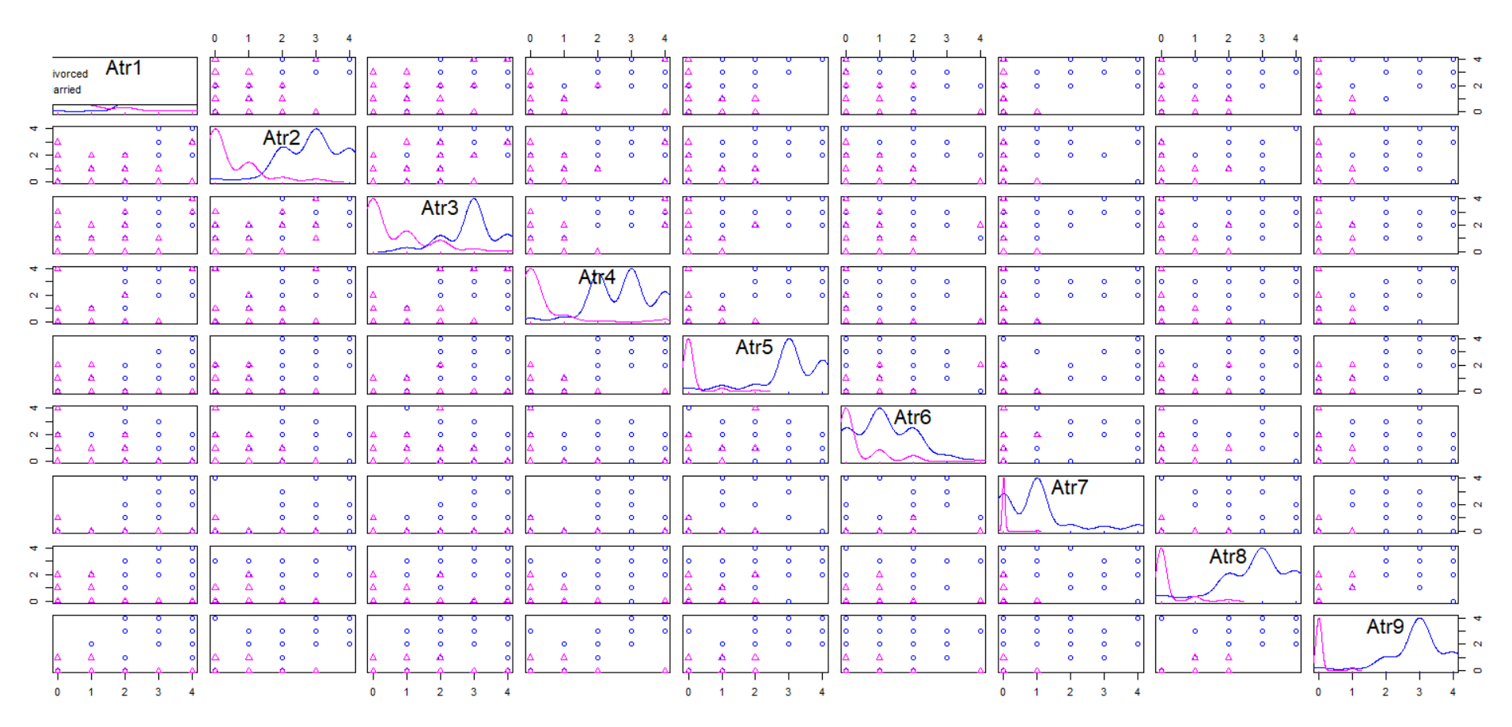
SCATTERPLOT MATRIX OF DIVORCE V/S ATTRIBUTES 1-9

Slide 6
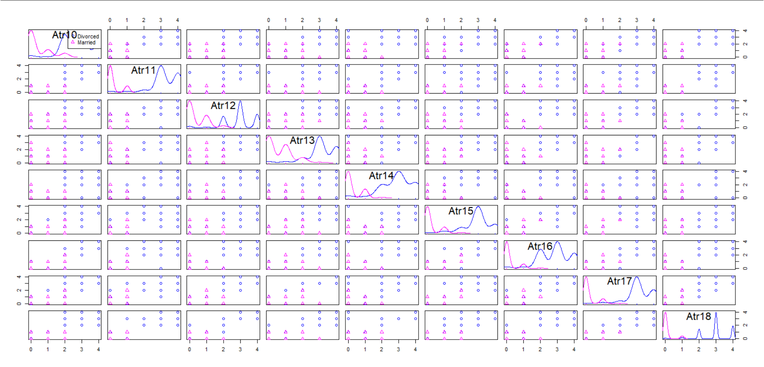
SCATTERPLOT MATRIX OF DIVORCE V/S ATTRIBUTES 10-18

Slide 7
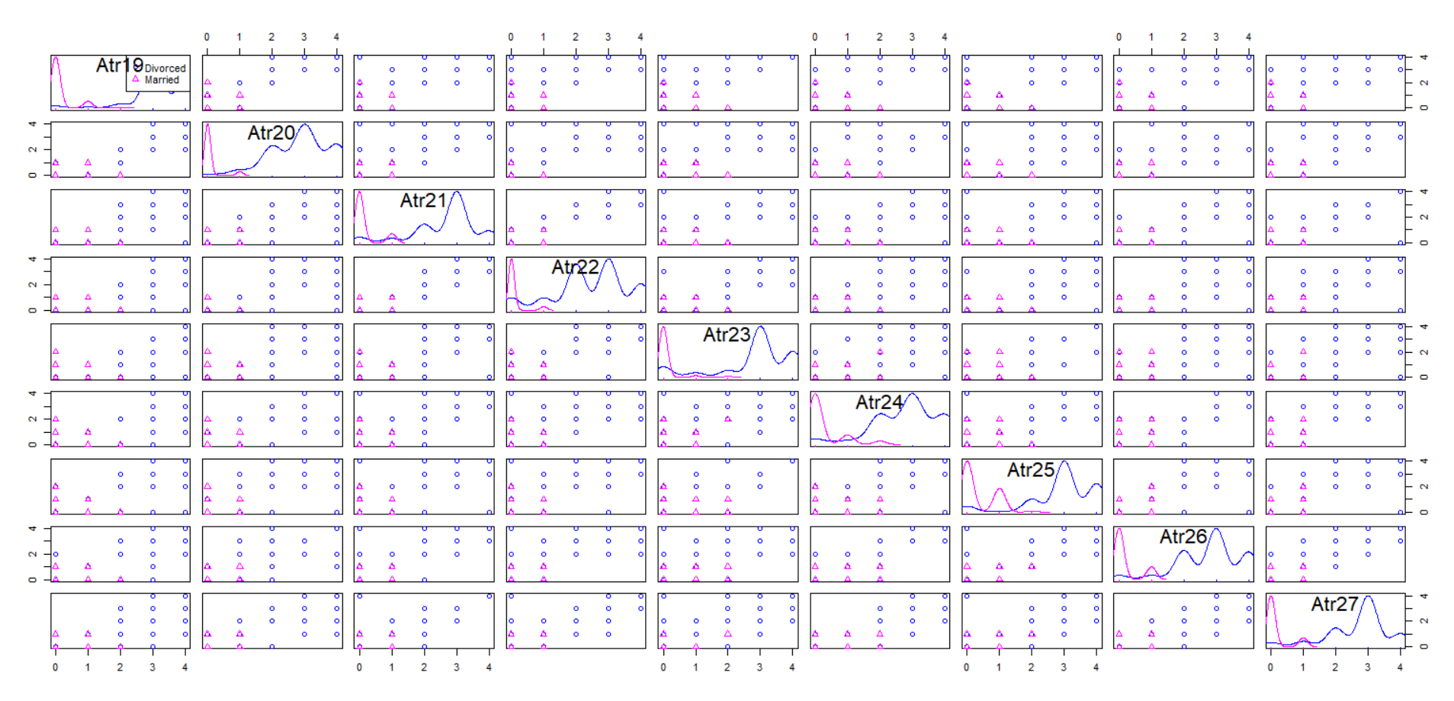
SCATTERPLOT MATRIX OF DIVORCE V/S ATTRIBUTES 19-27

Slide 8
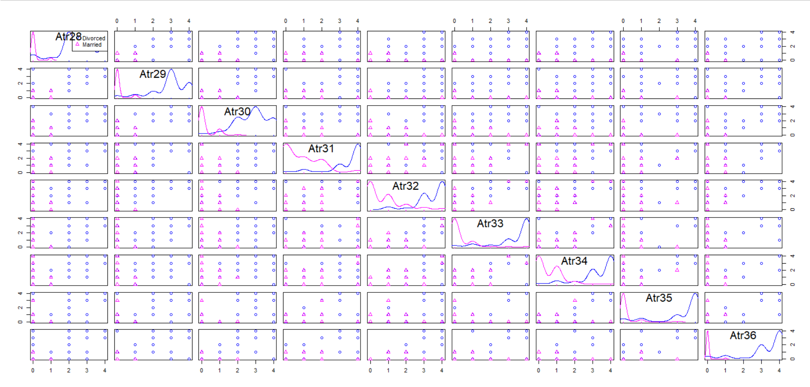
SCATTERPLOT MATRIX OF DIVORCE V/S ATTRIBUTES 28-36

Slide 9
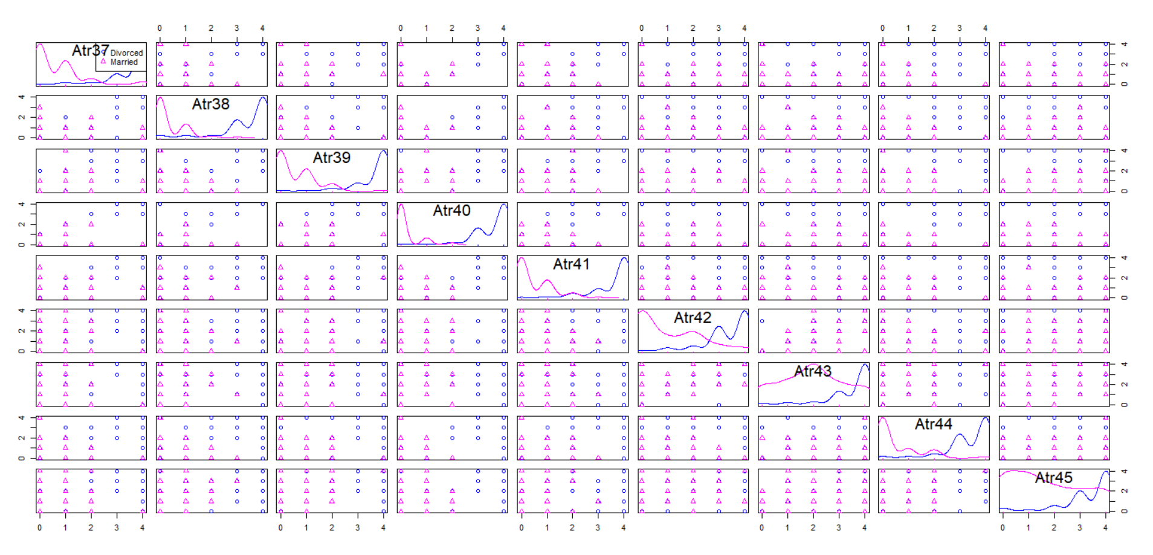
SCATTERPLOT MATRIX OF DIVORCE V/S ATTRIBUTES 37-45

Slide 10
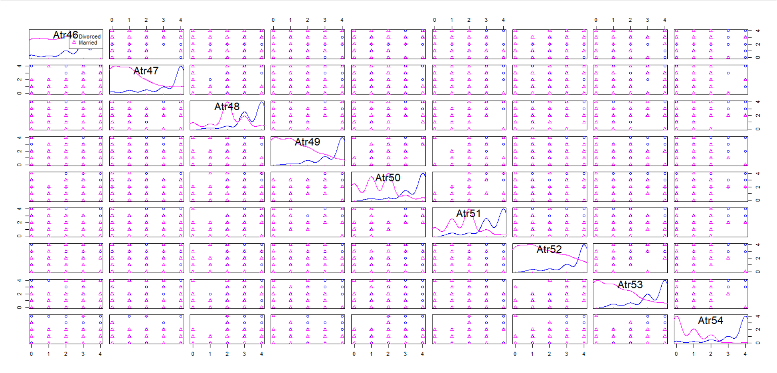
SCATTERPLOT MATRIX OF DIVORCE V/S ATTRIBUTES 46-54

Slide 11
GRAPHS WITH NO RELATIONSHIP BETWEEN PAIR OF QUESTIONS

Slide 12
R CODE TO FIND WEAKEST 10 CORRELATION BETWEEN 54 ATTRIBUTES
divorce <- read_excel("C:/Users/DELL/Desktop/divorce.xlsx")
View(divorce)
my_data <- divorce[, c(1:54)]
res <- cor(my_data)
sort(res,decreasing=F)[1:10]
[1] 0.06984964 0.06984964 0.09482031 0.09482031 0.10284253 0.10284253 0.12775852 0.12775852
[9] 0.14992964 0.14992964

Slide 13
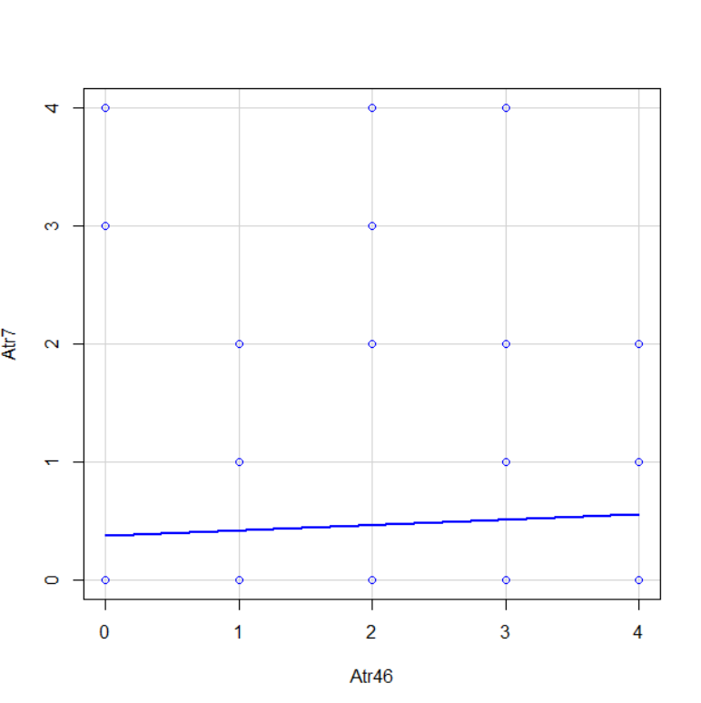
GRAPHS WITH NO RELATIONSHIP BETWEEN PAIRS OF QUESTIONS
 | Atr45 | Atr46
Atr1 | 0.51016 | 0.400296
Atr2 | 0.489062 | 0.389519
Atr3 | 0.427409 | 0.308149
Atr4 | 0.446798 | 0.34024
Atr5 | 0.591656 | 0.470758
Atr6 | 0.09482 | 0.127759
Atr7 | 0.199548 | 0.06985

Slide 14
ATTRIBUTE 7 V/S 46
Attribute | List of Questions
Atr46 | Even if I'm right in the discussion, I stay silent to hurt my spouse.
Atr7 | We are like two strangers who share the same environment at home rather than family.

Slide 15
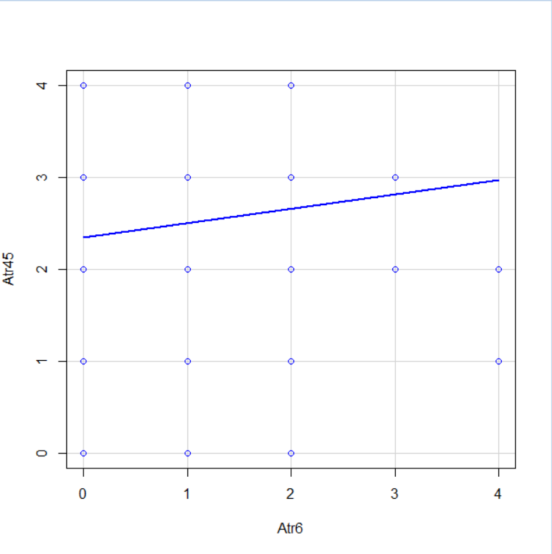
GRAPHS WITH NO RELATIONSHIP BETWEEN PAIRS OF QUESTIONS
 | Atr6 | Atr7
Atr1 | 0.28714 | 0.427989
Atr2 | 0.102843 | 0.417616
Atr45 | 0.09482 | 0.199548
Atr46 | 0.127759 | 0.06985
Atr47 | 0.212979 | 0.254225
Atr48 | 0.200673 | 0.31111

Slide 16
ATTRIBUTE 6 V/S 45
Attribute | List of Questions
Atr6 | We don't have time at home as partners.
Atr45 | I'd rather stay silent than discuss with my spouse.

Slide 17
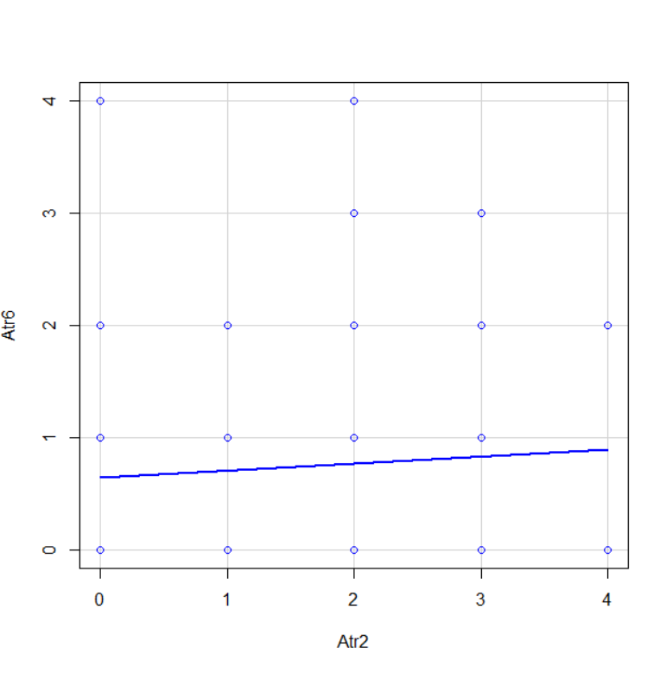
GRAPHS WITH NO RELATIONSHIP BETWEEN PAIRS OF QUESTIONS
 | Atr1 | Atr2
Atr1 | 1 | 0.819066
Atr2 | 0.819066 | 1
Atr3 | 0.832508 | 0.805876
Atr4 | 0.825066 | 0.791313
Atr5 | 0.881272 | 0.81936
Atr6 | 0.28714 | 0.102843

Slide 18
ATTRIBUTE 2 V/S 6
Attribute | List of Questions
Atr6 | We don't have time at home as partners.
Atr2 | I know we can ignore our differences, even if things get hard sometimes.

Slide 19
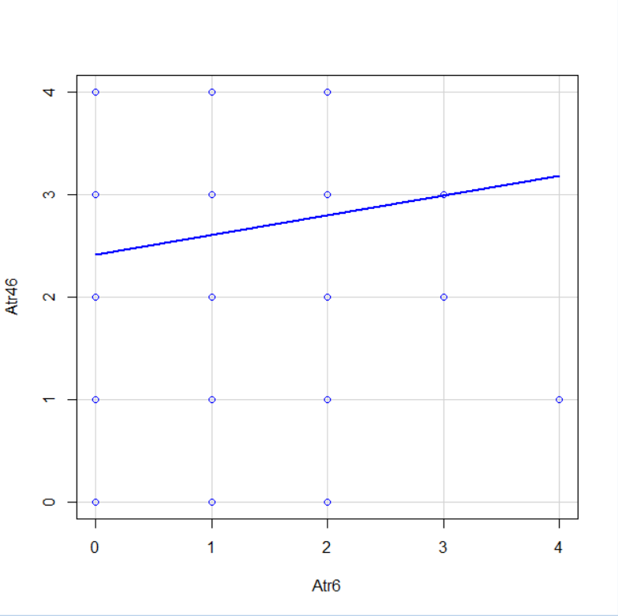
GRAPHS WITH NO RELATIONSHIP BETWEEN PAIRS OF QUESTIONS
 | Atr5 | Atr6
Atr43 | 0.613142 | 0.171599
Atr44 | 0.799453 | 0.339918
Atr45 | 0.591656 | 0.09482
Atr46 | 0.470758 | 0.127759

Slide 20
ATTRIBUTE 6 V/S 46
Attribute | List of Questions
Atr6 | We don't have time at home as partners.
Atr46 | Even if I'm right in the discussion, I stay silent to hurt my spouse.

Slide 21
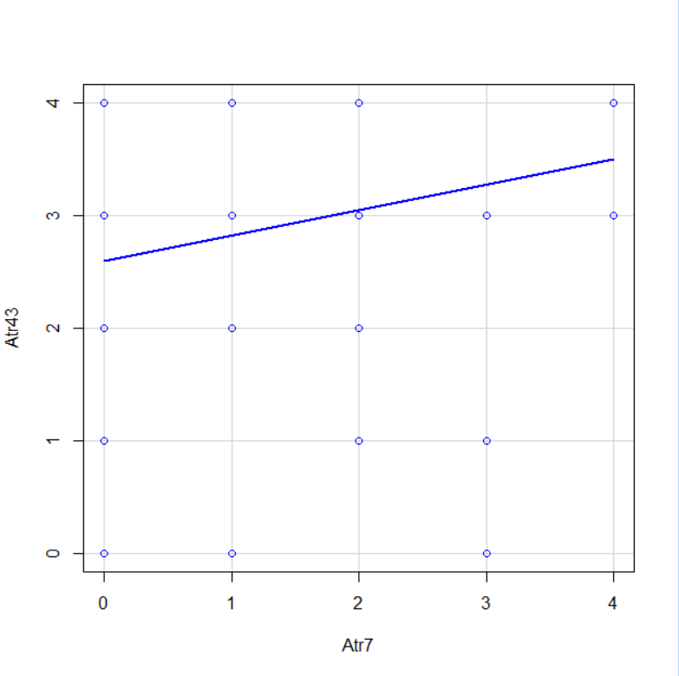
GRAPHS WITH NO RELATIONSHIP BETWEEN PAIRS OF QUESTIONS
 | Atr6 | Atr7
Atr43 | 0.171599 | 0.14993
Atr44 | 0.339918 | 0.425874
Atr45 | 0.09482 | 0.199548
Atr46 | 0.127759 | 0.06985
Atr47 | 0.212979 | 0.254225
Atr48 | 0.200673 | 0.31111

Slide 22
ATTRIBUTE 7 V/S 43
Attribute | List of Questions
Atr7 | We are like two strangers who share the same environment at home rather than family
Atr43 | I mostly stay silent to calm the environment a little bit.

Slide 23
GRAPHS WITH PAIRS OF CONTINUOUS VARIABLES AND DIVORCE EVENTS

Slide 24
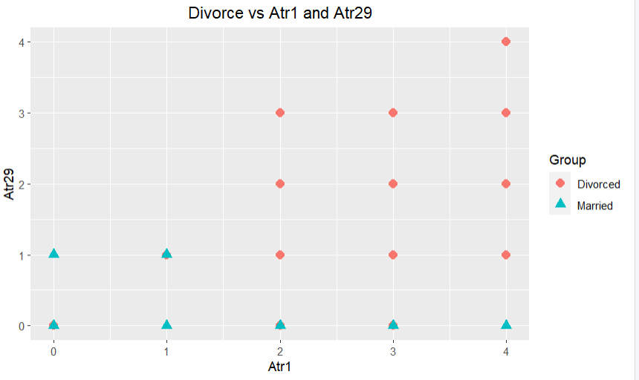

Slide 25
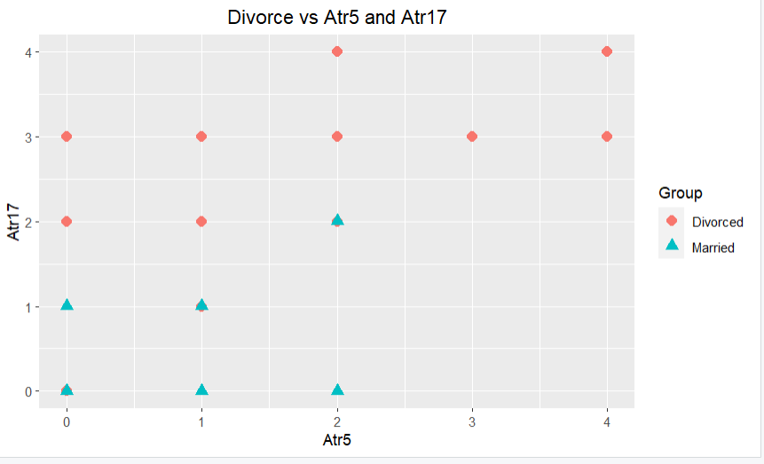

Slide 26
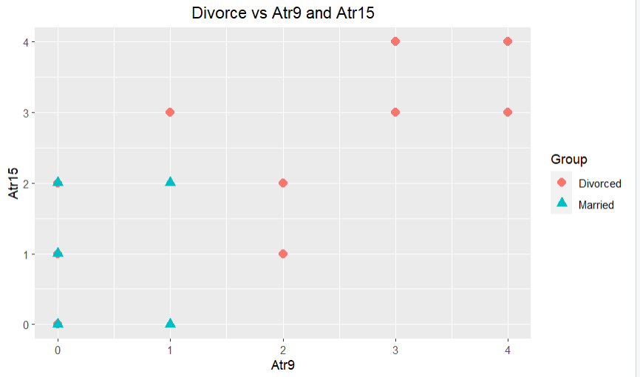

Slide 27
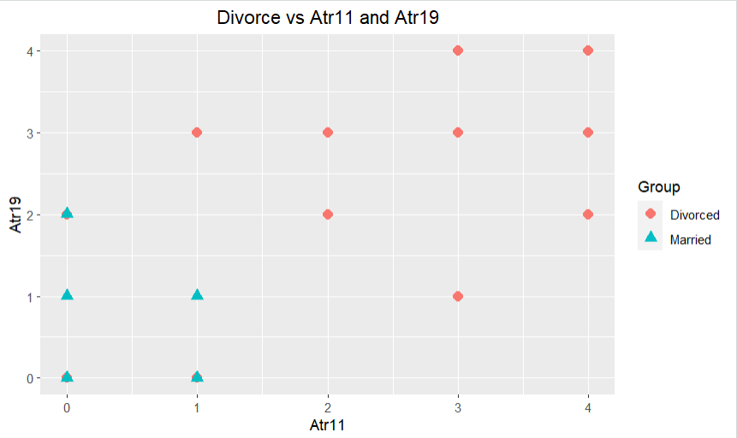

Slide 28
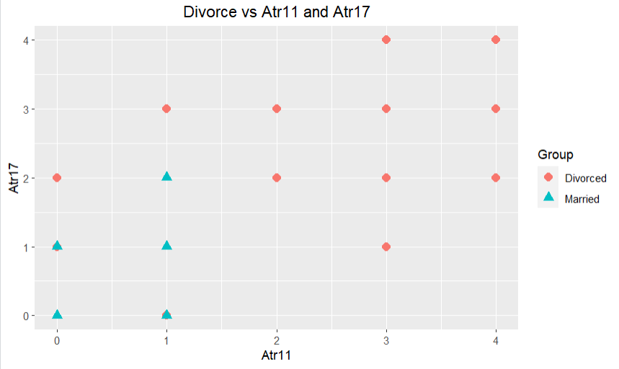

Slide 29

VARIANCE INFLATION FACTOR (VIF)

Slide 30
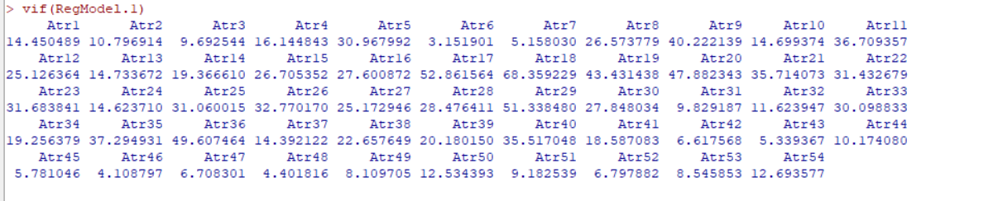
VIF ANALYSIS

Slide 31
VIF ANALYSIS
Atr1 | Atr2 | Atr3 | Atr4 | Atr5 | Atr6 | Atr7 | Atr8 | Atr9 | Atr10 | Atr11
14.45049 | 10.79691 | 9.692544 | 16.14484 | 30.96799 | 3.151901 | 5.15803 | 26.57378 | 40.22214 | 14.69937 | 36.70936
 | Atr12 | Atr13 | Atr14 | Atr15 | Atr16 | Atr17 | Atr18 | Atr19 | Atr20 | Atr21 | Atr22
25.12636 | 14.73367 | 19.36661 | 26.70535 | 27.60087 | 52.86156 | 68.35923 | 43.43144 | 47.88234 | 35.71407 | 31.43268
 | Atr23 | Atr24 | Atr25 | Atr26 | Atr27 | Atr28 | Atr29 | Atr30 | Atr31 | Atr32 | Atr33
31.68384 | 14.62371 | 31.06002 | 32.77017 | 25.17295 | 28.47641 | 51.33848 | 27.84803 | 9.829187 | 11.62395 | 30.09883
 | Atr34 | Atr35 | Atr36 | Atr37 | Atr38 | Atr39 | Atr40 | Atr41 | Atr42 | Atr43 | Atr44
19.25638 | 37.29493 | 49.60746 | 14.39212 | 22.65765 | 20.18015 | 35.51705 | 18.58708 | 6.617568 | 5.339367 | 10.17408
 | Atr45 | Atr46 | Atr47 | Atr48 | Atr49 | Atr50 | Atr51 | Atr52 | Atr53 | Atr54
 | 5.781046 | 4.108797 | 6.708301 | 4.401816 | 8.109705 | 12.53439 | 9.182539 | 6.797882 | 8.545853 | 12.69358

Slide 32
VIF ANALYSIS
Question | VIF
Atr6 | 3.151901
Atr46 | 4.108797
Atr48 | 4.401816
Atr7 | 5.15803
Atr43 | 5.339367
Atr45 | 5.781046
Atr42 | 6.617568
Atr47 | 6.708301
Atr52 | 6.797882
Atr49 | 8.109705
Atr53 | 8.545853
Atr51 | 9.182539
Atr3 | 9.692544
Atr31 | 9.829187
Atr44 | 10.17408
Atr2 | 10.796914
Atr32 | 11.623947
Atr50 | 12.534393
Atr54 | 12.693577
Atr37 | 14.392122
Atr1 | 14.450489
Atr24 | 14.62371
Atr10 | 14.699374
Atr13 | 14.733672
Atr4 | 16.144843
Atr41 | 18.587083
Atr34 | 19.256379
Atr14 | 19.36661
Atr39 | 20.18015
Atr38 | 22.657649
Atr12 | 25.126364
Atr27 | 25.172946
Atr8 | 26.573779
Atr15 | 26.705352
Atr16 | 27.600872
Atr30 | 27.848034
Atr28 | 28.476411
Atr33 | 30.098833
Atr5 | 30.967992
Atr25 | 31.060015
Atr22 | 31.432679
Atr23 | 31.683841
Atr26 | 32.77017
Atr40 | 35.517048
Atr21 | 35.714073
Atr11 | 36.709357
Atr35 | 37.294931
Atr9 | 40.222139
Atr19 | 43.431438
Atr20 | 47.882343
Atr36 | 49.607464
Atr29 | 51.33848
Atr17 | 52.861564
Atr18 | 68.359229

Slide 33
ATTRIBUTES WITH VIF<8
Attribute | VIF | List of Questions
Atr6 | 3.151901 | We don't have time at home as partners.
Atr46 | 4.108797 | Even if I'm right in the discussion, I stay silent to hurt my spouse.
Atr48 | 4.401816 | I feel right in our discussions.
Atr7 | 5.15803 | We are like two strangers who share the same environment at home rather than family.
Atr43 | 5.339367 | I mostly stay silent to calm the environment a little bit.
Atr45 | 5.781046 | I'd rather stay silent than discuss with my spouse.
Atr42 | 6.617568 | When I argue with my spouse, ı only go out and I don't say a word.
Atr47 | 6.708301 | When I discuss with my spouse, I stay silent because I am afraid of not being able to control my anger.
Atr52 | 6.797882 | I wouldn't hesitate to tell my spouse about her/his inadequacy.

Slide 34
CORRELATION MATRIX BETWEEN 9 ATTRIBUTES WITH VIF<8
 | Atr6 | Atr7 | Atr42 | Atr43 | Atr45 | Atr46 | Atr47 | Atr48 | Atr52
Atr6 | 1 | 0.42421224 | 0.227993 | 0.171599 | 0.09482 | 0.127759 | 0.212979 | 0.200673 | 0.205056
Atr7 | 0.42421224 | 1 | 0.333211 | 0.14993 | 0.199548 | 0.06985 | 0.254225 | 0.31111 | 0.243104
Atr42 | 0.22799335 | 0.33321101 | 1 | 0.719095 | 0.675723 | 0.548272 | 0.717083 | 0.618045 | 0.580543
Atr43 | 0.17159894 | 0.14992964 | 0.719095 | 1 | 0.775103 | 0.561868 | 0.69556 | 0.409197 | 0.51379
Atr45 | 0.09482031 | 0.19954849 | 0.675723 | 0.775103 | 1 | 0.592041 | 0.720692 | 0.413413 | 0.495944
Atr46 | 0.12775852 | 0.06984964 | 0.548272 | 0.561868 | 0.592041 | 1 | 0.664794 | 0.448773 | 0.55021
Atr47 | 0.21297863 | 0.25422502 | 0.717083 | 0.69556 | 0.720692 | 0.664794 | 1 | 0.602951 | 0.571223
Atr48 | 0.20067288 | 0.31110962 | 0.618045 | 0.409197 | 0.413413 | 0.448773 | 0.602951 | 1 | 0.513645
Atr52 | 0.20505634 | 0.24310427 | 0.580543 | 0.51379 | 0.495944 | 0.55021 | 0.571223 | 0.513645 | 1

Slide 35
PAIR OF QUESTIONS WITH HIGH CORRELATION
Attribute | VIF | List of Questions
Atr43 | 5.339367 | I mostly stay silent to calm the environment a little bit.
Atr42 | 6.617568 | When I argue with my spouse, ı only go out and I don't say a word.
Attribute | VIF | List of Questions
Atr42 | 6.617568 | When I argue with my spouse, ı only go out and I don't say a word.
Atr47 | 6.708301 | When I discuss with my spouse, I stay silent because I am afraid of not being able to control my anger.
Attribute | VIF | List of Questions
Atr43 | 5.339367 | I mostly stay silent to calm the environment a little bit.
Atr45 | 5.781046 | I'd rather stay silent than discuss with my spouse.
Attribute | VIF | List of Questions
Atr45 | 5.781046 | I'd rather stay silent than discuss with my spouse.
Atr47 | 6.708301 | When I discuss with my spouse, I stay silent because I am afraid of not being able to control my anger.

Slide 36
NEURAL NETWORK-BINARY OUTPUT

Slide 37
Neural network with Binary Output Class using the Nine Attributes (Atr) from the VIF analysis and all data points

Slide 38
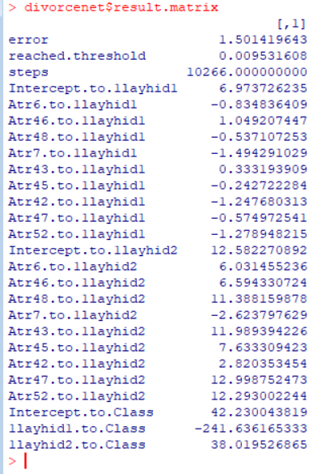
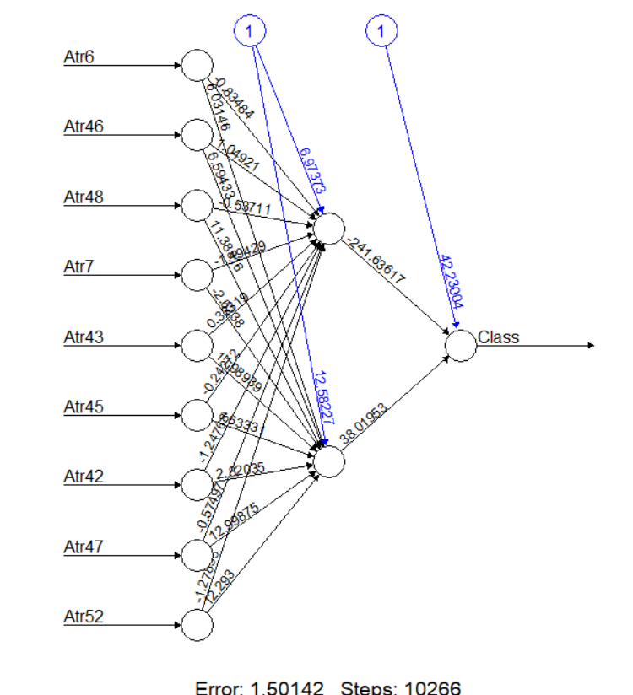
NEURAL NETWORK OUTPUT
divorcenet <- neuralnet(Class ~ Atr6+ Atr46+Atr48+Atr7+Atr43+Atr45+Atr42+Atr47+Atr52, divorce, hidden=2, lifesign="minimal", linear.output=FALSE, threshold=0.01)
divorcenet$result.matrix
plot(divorcenet)

Slide 39
Neural Network 2 with Binary Output Class using the Nine Attributes (Atr) from the VIF analysis and all Data Points using 50% Training Data, Randomly selected

Slide 40
NEURAL NETWORK 2 WITH 50% TRAINING DATA RANDOMLY SELECTED
divorce_index <- sample(nrow(divorce), 1/2 * nrow(divorce))
divorce_train <- divorce[divorce_index, ]
divorce_test <- divorce[-divorce_index, ]
head(divorce_train)
head(divorce_test)
divorcenet <- neuralnet(Class ~ Atr6+ Atr46+Atr48+Atr7+Atr43+Atr45+Atr42+Atr47+Atr52, divorce_train, hidden=2, lifesign="minimal", linear.output=FALSE, threshold=0.01)
plot(divorcenet)
temp_test <- subset(divorce_test, select=c("Atr46","Atr48","Atr7","Atr43","Atr52","Atr6","Atr47","Atr45","Atr42"))
head(temp_test)

Slide 41
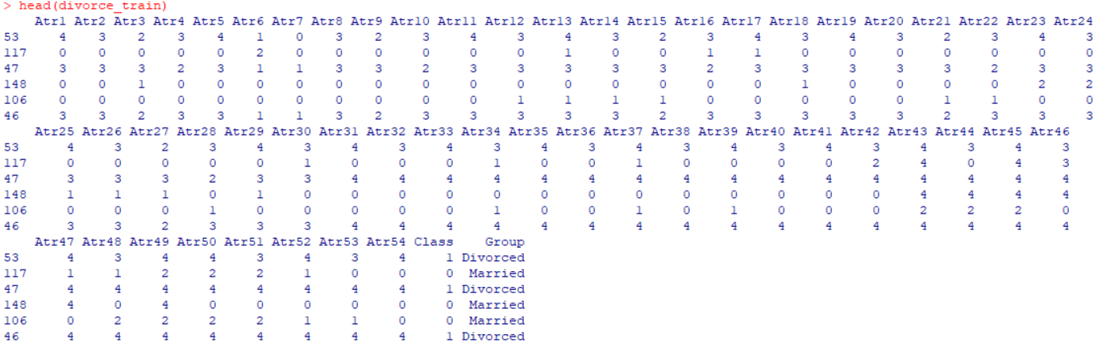
50% TRAINING DATA

Slide 42
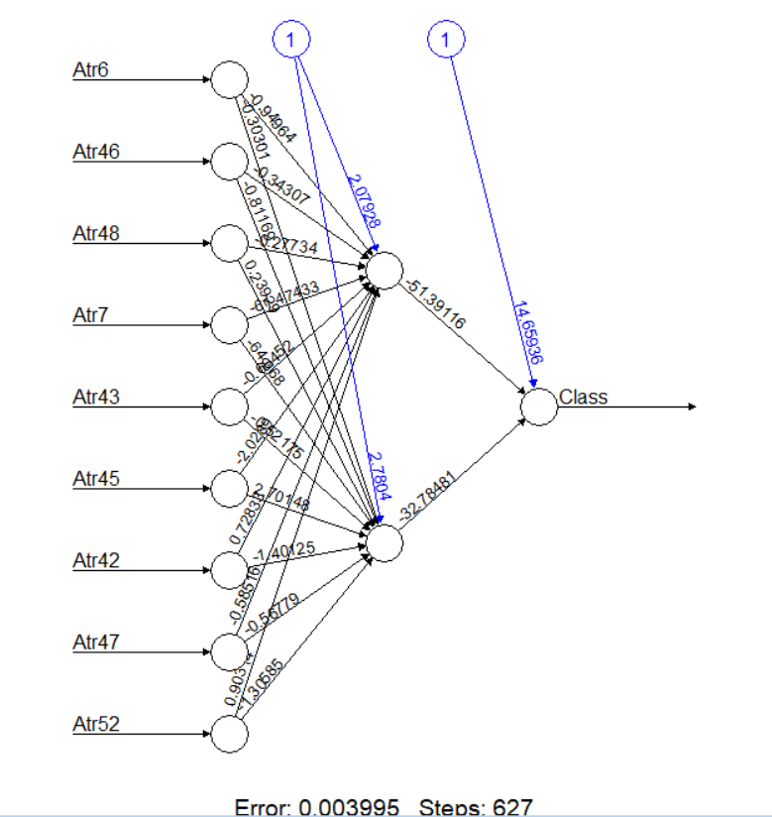
DIVORCENET PLOT WITH 50% TRAINING DATA

Slide 43
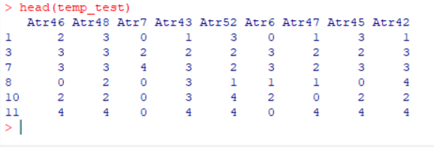
50% RANDOM TESTING DATA

Slide 44

PREDICTION ON 50% TESTING DATA

Slide 45
divorcenet.results <- compute(divorcenet, temp_test)
results <- data.frame(actual=divorce_test$Class, prediction=divorcenet.results$net.result)
results[1:20,]
results$prediction <- round(results$prediction)
results [1:20,]

Slide 46
PREDICTION OUTCOME FIRST 20 ROWS- ALL CORRECT PREDICTIONS
Index | Actual | Prediction
1 | 1 | 1
3 | 1 | 1
7 | 1 | 1
8 | 1 | 1
10 | 1 | 1
11 | 1 | 1
12 | 1 | 1
13 | 1 | 1
14 | 1 | 1
15 | 1 | 1
16 | 1 | 1
18 | 1 | 1
20 | 1 | 1
21 | 1 | 1
22 | 1 | 1
27 | 1 | 1
31 | 1 | 1
32 | 1 | 1
33 | 1 | 1
35 | 1 | 1

Slide 47
Third Neural Network with Binary Output Class using the Attributes Atr7, Atr43, Atr46, At48, Atr52

Slide 48
NEURAL NETWORK 3
divorce_index <- sample(nrow(divorce), 1/2 * nrow(divorce))
divorce_train <- divorce[divorce_index, ]
divorce_test <- divorce[-divorce_index, ]
head(divorce_train)
head(divorce_test)
divorcenet <- neuralnet(Class ~ Atr46+Atr48+Atr7+Atr43+Atr52, divorce_train, hidden=2, lifesign="minimal", linear.output=FALSE, threshold=0.01)
plot(divorcenet)
temp_test <- subset(divorce_test, select = c("Atr46","Atr48","Atr7","Atr43","Atr52"))
head(temp_test)

Slide 49
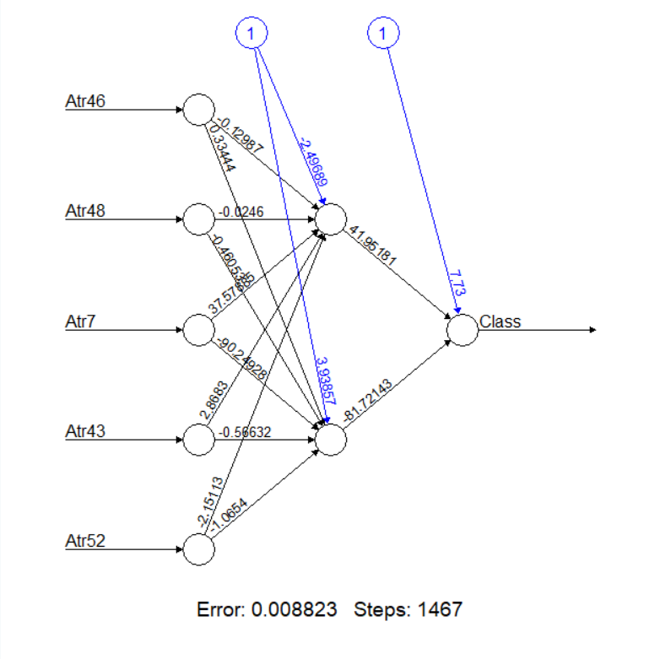
PLOT

Slide 50
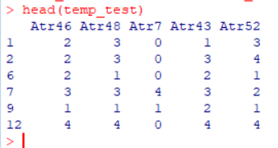
TESTING DATA

Slide 51
PREDICTION ON 50% TESTING DATA

Slide 52
divorcenet.results <- compute(divorcenet, temp_test)
results <- data.frame(actual=divorce_test$Class, prediction=divorcenet.results$net.result)
results[1:20,]
results$prediction <- round(results$prediction)
results [1:20,]

Slide 53
PREDICTION OUTCOME FIRST 20 ROWS -2 INCORRECT PREDICTIONS
Index | Actual | Prediction
1 | 1 | 0
2 | 1 | 1
6 | 1 | 0
7 | 1 | 1
9 | 1 | 1
12 | 1 | 1
13 | 1 | 1
17 | 1 | 1
20 | 1 | 1
22 | 1 | 1
28 | 1 | 1
30 | 1 | 1
32 | 1 | 1
33 | 1 | 1
38 | 1 | 1
39 | 1 | 1
40 | 1 | 1
43 | 1 | 1
44 | 1 | 1
45 | 1 | 1

Slide 54
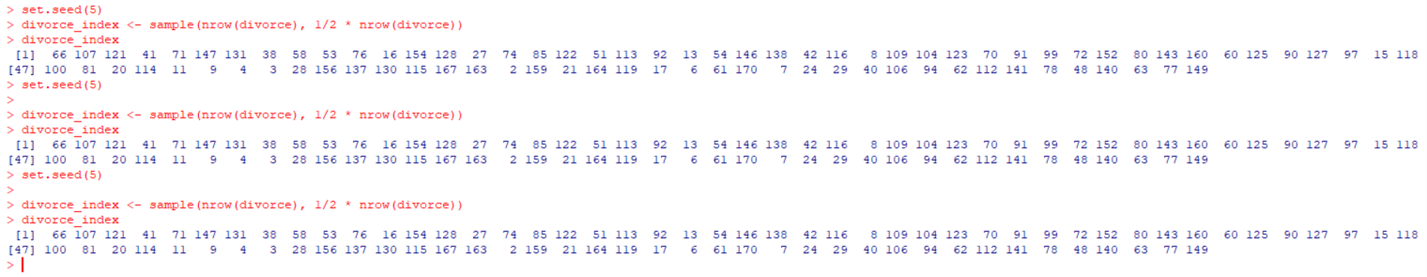
USING SEED FUNCTION TO GET SAME SAMPLE EVERYTIME

Slide 55
NEURAL NETWORK 2 V/S NEURAL NETWORK 3 PREDICTION COMPARISION
Random Sample | Total Rows in Test Dataset | Number of Rows Correctly Predicted by NN2 | Number of Rows Correctly Predicted by NN3 | Neural Network 2 Correct Prediction % | Neural Network 3 Correct Prediction%
set.seed(1) | 85 | 52 | 75 | 61.18% | 88.24%
set.seed(2) | 85 | 49 | 78 | 57.65% | 91.76%
set.seed(3) | 85 | 47 | 77 | 55.29% | 90.59%
set.seed(4) | 85 | 49 | 78 | 56.47% | 91.76%
set.seed(5) | 85 | 48 | 79 | 56.47% | 92.94%
set.seed(6) | 85 | 44 | 77 | 51.76% | 90.59%
set.seed(7) | 85 | 48 | 76 | 56.47% | 89.41%

Slide 56
CONFUSION MATRIX
 | Predictions
Actual Data |  | Married | Divorced
 | Married | 8 | 36
 | Divorced | 1 | 40

Slide 57
CONCLUSION
Accuracy of Neural Network 3 is way too high than Neural Network 2
There is a very high correlation between Attributes Atr6,Atr47,Atr45,Atr42

Slide 58
WHEN DO VISUALIZATIONS HELP ? WHEN THEY DO NOT?

Slide 59
WHEN VISUALIZATIONS DO NOT HELP
When the dataset is huge and there are many independent variables
It’s very difficult to interpret relationship between X variables and divorce event in the scatterplot matrix
Splitting scatterplot matrix into groups of 6 as there are 54 independent variables
Difficult to plot relationship between for e.g. attribute 9 and attribute 10

Slide 60
WHEN VISUALIZATIONS HELPS
Scatterplot helps in understanding the relationship between two attributes and plot divorce events
Gives a clear picture compared to scatterplot matrix

Slide 61

THANK YOU
QUESTIONS?

